Slide 1
Description Logic
Examples
OWL Pizzas:Practical Experience of Teaching OWL-DL: Common Errors & Common Patterns
Ekaw2004.pdf

Slide 2
Most common difficulties encountered by newcomers to the language
Failure to make all information explicit - assuming that information implicit in names is “represented” and available to the classifier.
Mistaken use of universal rather than existential restrictions as the default
Open world reasoning
The effect of range and domain constraints as axioms

Slide 3
The additional problems posed by:
Trivial satisfiability of universal restrictions – that “only” (allValuesFrom) does not imply “some” (someValuesFrom).
The difference between defined and primitive classes and the mechanics of converting one to the other.
Errors in understanding common logical constructs.
Expecting classes to be disjoint by default.
The difficulty of understanding subclass axioms used for implication.

Slide 4
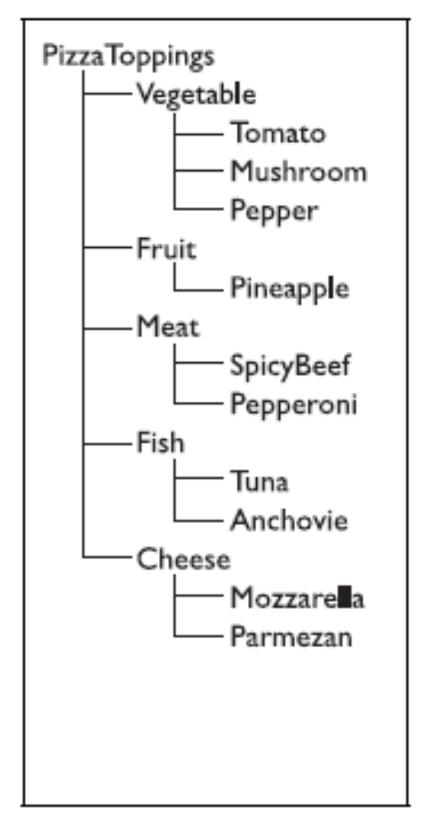
A simple taxonomy of pizza toppings
Subsumption in OWL means necessary implication
“All Pepperoni is Meat”,
“All Meat is a Pizza topping”
Does this mean that Meat and Fish and Vegetables etc. are all different?
Can there be anything that is both Meat and
Vegetable?
in OWL, classes are overlapping until disjointness axioms are entered.

Slide 5
One of the most common errors in building ontologies in OWL has been to omit the disjointness axioms.
To help users manage disjointness axioms, the Prot´eg´e -OWL-COODE interface makes entering them easy by providing a single button to add or remove disjointness axioms amongst all siblings of a given parent

Slide 6
Work done based upon the disjoint knowledge omission

Slide 7


Slide 8
Development of a syntactically and semantically correct ontology is a challenging task for the ontology developers.
Mapping and merging
“Identification of incomplete concepts (incompleteness errors are logical) by using automated tools is very difficult as the definitions are syntactically correct [5]. At the same time, it is very difficult for experts (ontology developers) to locate these errors for large and complex ontologies. Existing evaluators like Fact [7] and Racer [8] do not handle this situation.”

Slide 9
“We propose a solution to this dilemma. The solution is to detect such situations by using automated tools and generate warnings (as we cannot be 100% sure that this is an error or not) for the developers. We have defined and applied the warning criteria on multiple ontologies / case studies. One of the case studies is discussed in this paper.”

Slide 10
Disjoint Omission Warning Generator (DOWG)
Disjoint omission checker will generate warnings against the concepts that do not have overlapping with other concepts as well as no knowledge about their disjointness is given by the domain expert.
DOWG gets the ontology tree, selects concepts one by one and checks that whether other concepts are disjoint or overlapped with them. The warning will be generated against those that are not disjoint and overlap with selected concepts.

Slide 11
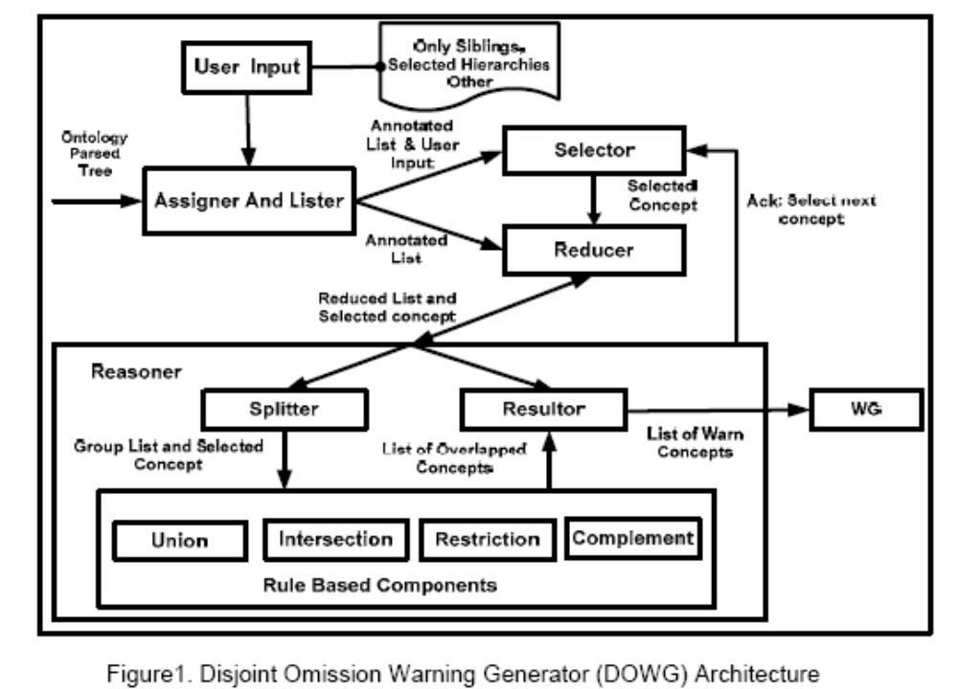

Slide 12
DOWG
To achieve this functionality, one needs to traverse the tree again and again which effects on time complexity.
For this purpose we have introduced a coding scheme which helps us not to traverse the tree again and again in elimination process. This coding scheme generates the codes to preserve all the required information about concepts, needed during elimination process.
The main goal of the assigner is to assign codes to each concept in such a way that if we compare selected concept with others then we can conclude some information from their code instead of traversing the ontology tree.

Slide 13
The information concluded from their code is as listed below
The concepts have parent or child relationship of any level with selected concept in ontology. We ignore these concepts because any concept cannot be disjoint with its any level parent concept or child concept.
The concepts already directly disjoint with selected concept. Directly disjoint means that the concepts have disjoint clause with it in the given ontology.
The concepts already indirectly disjoint with selected concept. Indirectly disjoint means that parent of any level of selected concept is disjoint with them or vice versa.
All subclass of the concepts which are directly or indirectly disjoint with selected concept
The concepts which satisfy any of above criteria are considered as ignorable concepts against selected concept during reasoning process.

Slide 14
Assigner and Lister
It assigns bit codes whenever a new disjointness occurs in the tree.
The code comprises of Concept_Id, Disjoint_Id and Parent_Mask, which help us to preserve the direct and indirect disjointness and parent child relationship.
Concept_Id is composed by appending a character (alphabet or any ASCII character) to its parent Concept_Id like if parent concept id is ‘A’ then its child id is Aa, Ab or Ac.
Disjoint id is calculated as
  Disjoint id = Disjoint id + disj seq no + Parent dis no
Disjoint_id is LogicalORing of current disjoint sequence number, parent disjoint id and itself. The size of Disjoint_id depends on the number of disjoints in ontology.

Slide 15
Selector And Reducer
Selector gets the annotated list from the Assigner. It Selects a node from the list according to the user input, passes it to the Reducer and waits until gets the acknowledgement from Reasoner.
The process will be continued until the last node of the list.
Reducer eliminated the ignorable concepts from list which are already explained in Assigner section. It provides the shorted list to Reasoner and saves the reasoning time.

Slide 16
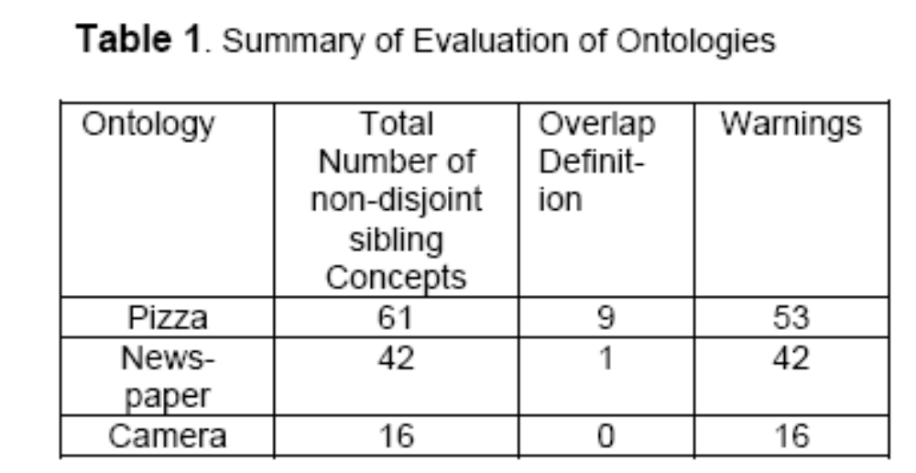

Slide 17
Back to
most common difficulties encountered by newcomers

Slide 18
Ontologies for DL Exercise
http://www.co-ode.org/ontologies/pizza/2007/02/12/owldoc/
LinKBase® is a large-scale medical ontology developed by L&C using the ontology authoring environment provided by LinKFactory®. LinKBase® contains over 1.5 million language-independent medical and general-purpose domain-entities,
The Open Biomedical Ontologies http://www.obofoundry.org/

Slide 19
understanding the exact meaning of OWL expressions

Slide 20
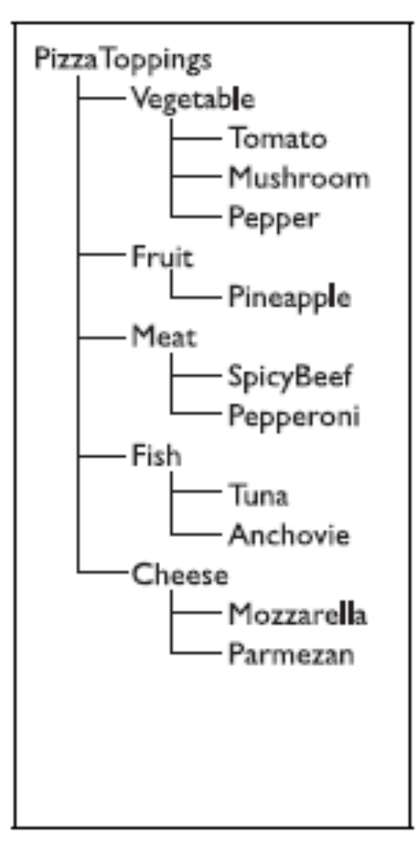
Questions?
Does this mean that Meat and Fish and Vegetables etc. are all different?
Can there be anything that is both Meat and Vegetable?

Slide 21
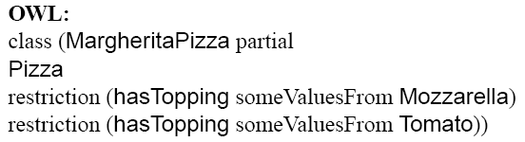
Properties and existential restrictions
all MargheritaPizza have Mozzarella and Tomato?
any pizzas having Mozzarella and Tomato are MargheritaPizza?
MargheritaPizza has Mozzarella and Tomato and nothing else?

Slide 22
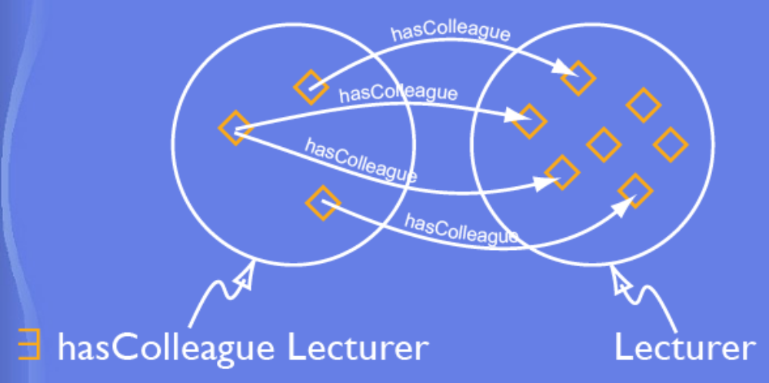
Paraphrase:
Margherita pizzas have, amongst other things, some mozzarella topping and also some tomato topping.
hasColleage
Professor
Error in the modeling lecture

Slide 23
A cheesey pizza is any pizza that has, amongst other things, some cheese topping.

Slide 24
OWL:
Class( CheeseyPizza complete
Pizza
restriction (hasTopping someValuesFrom Cheese))
any pizza that satisfies these conditions will be classified as a “cheesey pizza”
“Primitive” or Partial: classes for which there are only necessary conditions
“Defined” or Complete: classes Classes for which there is at least one set of necessary and sufficient conditions

Slide 25
the most common accidental error in implementing OWL ontologies
is to fail to make a set of restrictions a definition - i.e. to fail to make the definition “complete” rather than “partial”, or “necessary and sufficient” rather than just “necessary”.
nothing will be inferred to be subsumed under a primitive class by the classifier.
If “complete” is replaced by “partial”, then nothing will appear under CheesyPizza.
It is also possible to make the distinction using the difference between “SubClassOf” and “EquivalentClasses”

Slide 26
In other systems “negation as failure” –
  i.e. if something cannot be found, it is assumed to be absent, e.g. databases, logic programming, constraint languages in frame systems, etc.
In OWL
  OWL uses open world reasoning with negation as unsatisfiability - i.e. something is false only if it can be proved to contradict other information in the ontology.

Slide 27
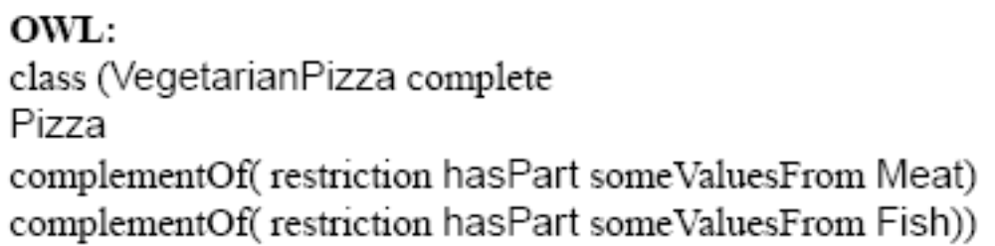
Paraphrase:
A vegetarian pizza is any pizza that, amongst other things, both does not have some meat topping and also does not have some fish topping.

Slide 28
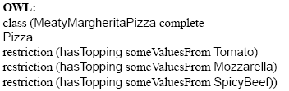
MargheritaPizza does not classify as Vegetarian-Pizza.
There is nothing in their definition that makes it contradictory to add meat or fish toppings.
For example the MeatyMargherita pizza defined

Slide 29
Paraphrase:
A meaty margherita pizza is any pizza which, amongst other things, has some tomato topping and also some mozzarella topping and also some spicy beef topping.

Slide 30
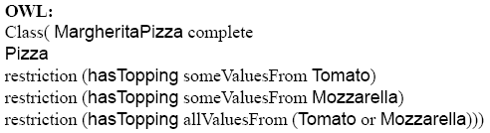
Required:
a Margherita pizza is a pizza that has mozzarella and tomato toppings and only those toppings.
The final restriction is known as a “closure restriction” or “closure axiom” because it closes off the possibility of further additions for a given property

Slide 31
“allValuesFrom” is paraphrased as “only”, because to say that all values come from a given class is the same as saying that values may only come from that class.
Paraphrase:
A margherita pizza is any pizza which, amongst other things, has some tomato topping and also some mozzarella toppings and also has only mozzarella and/or tomato toppings.
The phrase “amongst other things” in the paraphrase still allows space for a MargheritaPizza to have restrictions involving properties other than hasTopping - e.g. to represent that it is stale, overcooked, chopped into pieces etc. Anything except a margherita pizza with additional toppings.

Slide 32
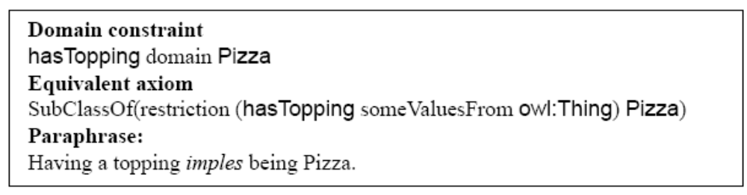
Domain and range constraints are axioms
Subsumption: “B is a subclass of A” means “B implies A”
if we set the domain of hasTopping to be Pizza,

